Slide 1


Slide 2
Chapter 19
Database Recovery Techniques

Slide 3
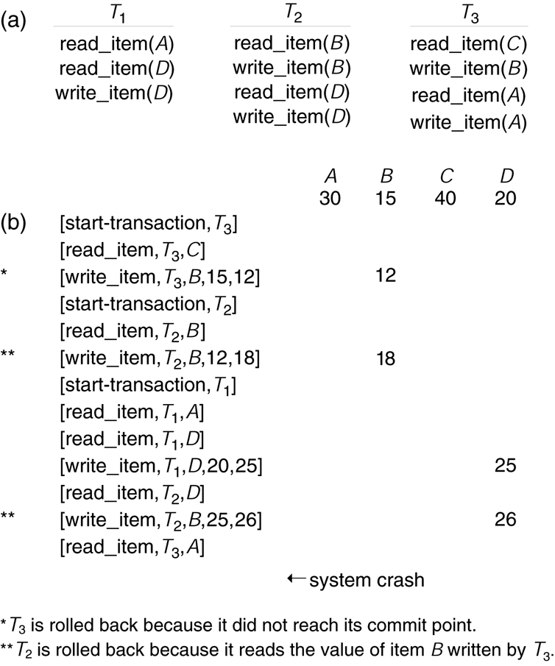
FIGURE 19.1
Illustrating cascading rollback (a process that never occurs in strict or cascadeless schedules). (a) The read and write operations of three transactions.
(b) System log at point of crash.

Slide 4
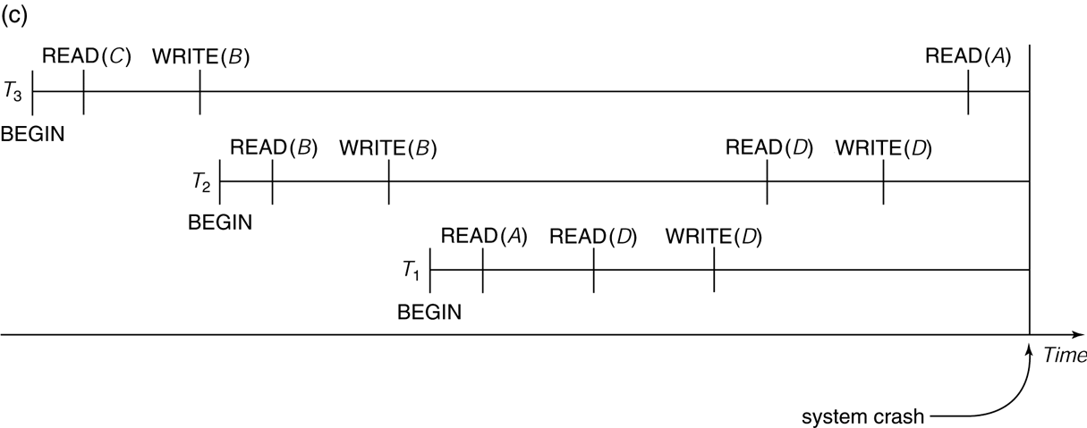
FIGURE 19.1 (continued)
Illustrating cascading rollback (a process that never occurs in strict or cascadeless schedules).
(c) Operations before the crash.

Slide 5
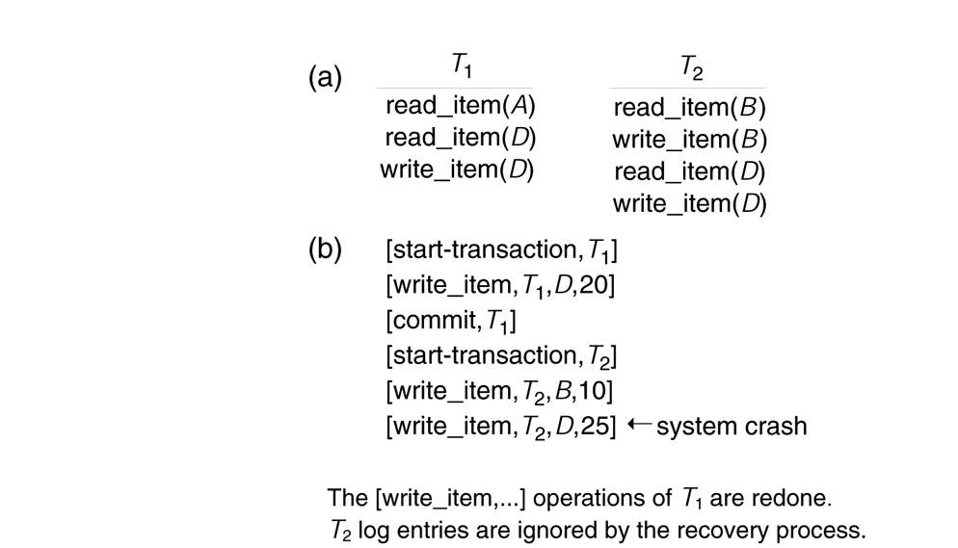
FIGURE 19.2
An example of recovery using deferred update in a single-user environment. (a) The READ and WRITE operations of two transactions. (b) The system log at the point of crash.

Slide 6
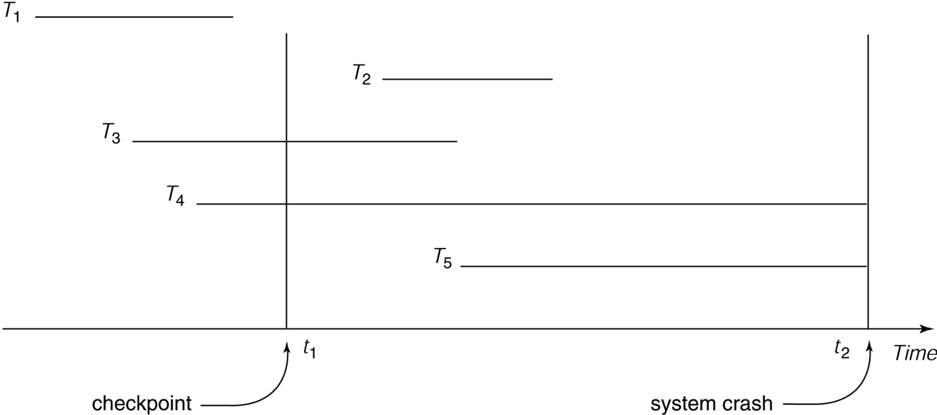
FIGURE 19.3
An example of recovery in a multiuser environment.

Slide 7
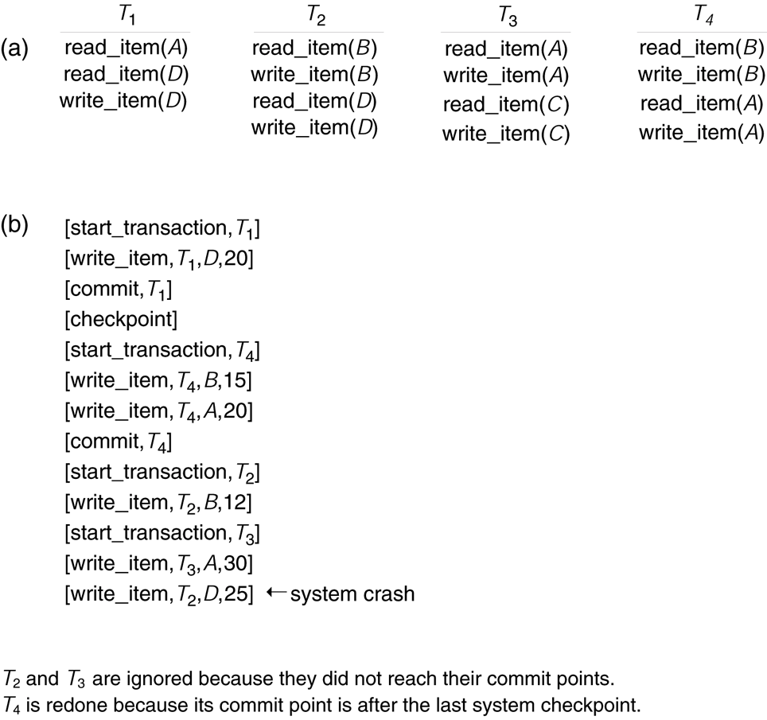
FIGURE 19.4
An example of recovery using deferred update with concurrent transactions.
(a) The READ and WRITE operations of four transactions. (b) System log at the point of crash.

Slide 8
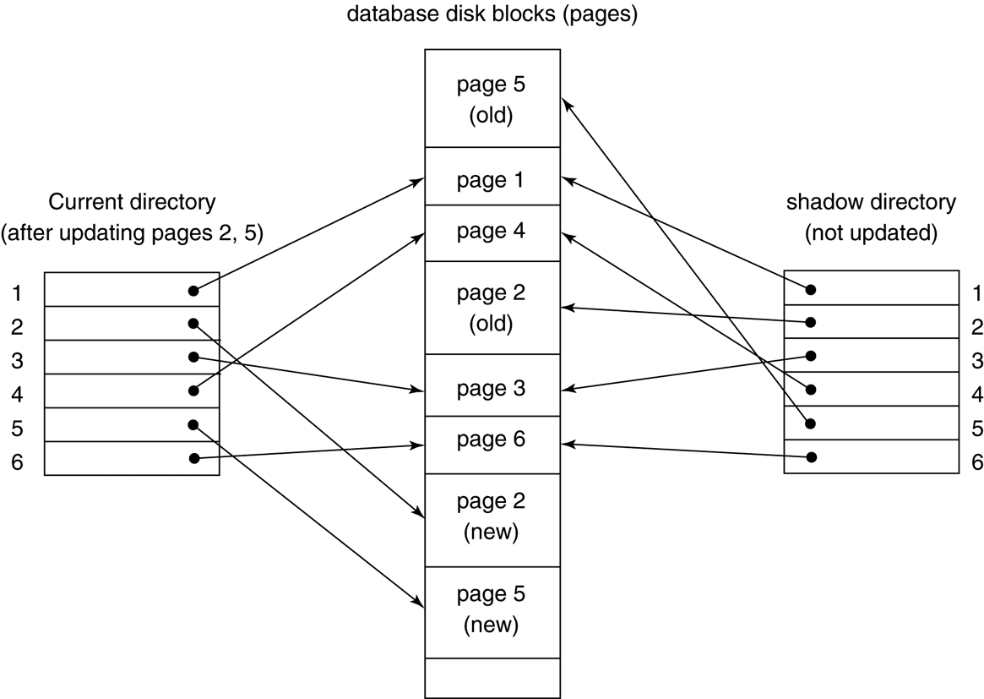
FIGURE 19.5
An example of shadow paging.

Slide 9
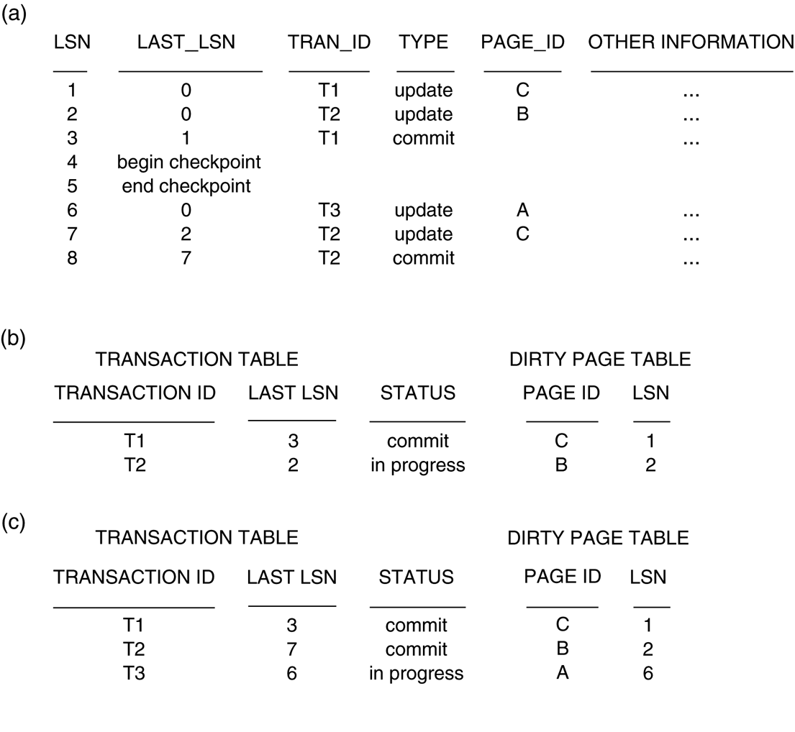
FIGURE 19.6
An example of recovery in ARIES. (a) The log at point of crash. (b) Transaction and Dirty Page Tables at time of checkpoint. (c) The Transaction and Dirty Page Tables after the analysis phase.

Slide 10
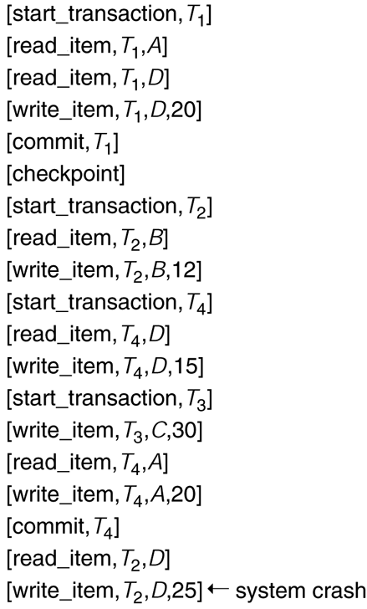
FIGURE 19.7
An example schedule and its corresponding log.

